Slide 1
Predicting Cardiovascular Disease with “Just” Poverty Rates
Elliot Ting

Slide 2
The Problem
Rising healthcare costs are a worldwide problem.
In 2015, the US spent ~3 times on healthcare as compared to the average of other countries with comparable incomes. (Source: Organization for Economic Co-operation and Development)
The US spends more on healthcare than any other country, but has middling health outcomes.
30th in the world in terms of life expectancy (Source: World Health Organization)

Slide 3
The Question to Answer
Can we satisfactorily predict Cardiovascular Mortality rates in the US, simply by using the poverty rate?

Slide 4
Why is this important?
According to the American Health Association, Cardiovascular Disease costs are projected to exceed $1 Trillion by 2035.
If we can accurately predict what the important factors of Cardiovascular mortality are, we can focus the majority of resources into improving those factors.

Slide 5
Why is this project of limited scope?
We are curious to see the predictive power of poverty rates in regards to cardiovascular mortality rates.
If poverty rate can satisfactorily predict cardiovascular mortality rate, we could justify spending more time and effort on reducing the poverty rate.
Of course, this would depend on the ease of reducing the poverty rate and the predictive power of other possible factors.

Slide 6
Dataset
Combination of :
US Census Poverty Rate Dataset
University of Washington’s Institute for Health Metrics and Evaluation Cardiovascular Mortality Rate dataset

Slide 7
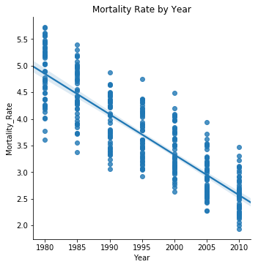
Exploratory Data Analysis – Are there obvious correlations?

Slide 8
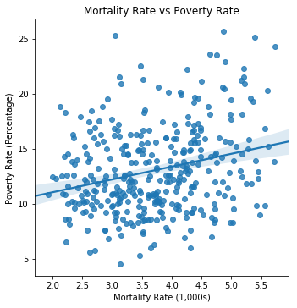
Exploratory Data Analysis – Are there obvious correlations?

Slide 9
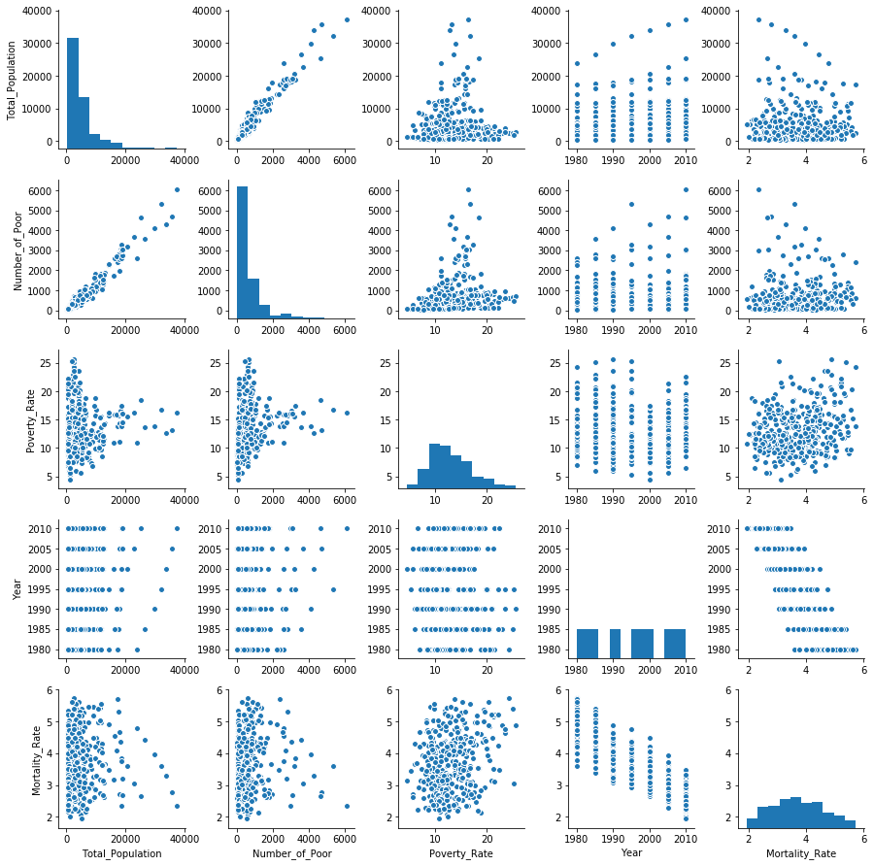
Exploratory Data Analysis

Slide 10
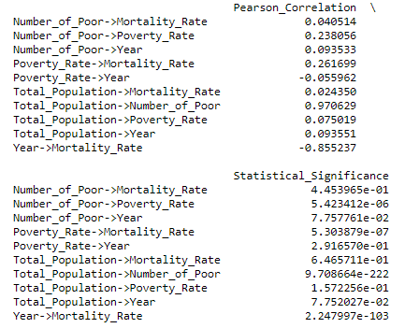
EDA: Overall Pearson Correlations

Slide 11
What are the statistically significant variables?
Year
Poverty Rate

Slide 12
What are the possible machine learning methods?
Mixed Effects Model Regression
Recurrent Neural Networks
Hidden Markov Models
We would have to ensure to use the cross-validation iterators for grouped data to avoid inflation of classifier accuracy if the same data point shows up in training and test data.
Any ‘standard’ method, given that we add features that represent the longitudinally of the data.

Slide 13
Machine Learning Technique – Linear Regression
Given the plethora of choices, we will stick with the tried and true method of linear regression to see what we can come up with.
Below are the results of the various models we tried:
Model | # Of Factors | Factor | Adjusted R-Squared | Errors?
linreg1 | 1 | Poverty Rate | 0.066 | N/A
linreg2 | 2 | Poverty Rate, Year | 0.776 | Possible Multicollinearity
linreg3 | 5 | State, Total Population, Number of Poor, Poverty Rate, Year | 0.973 | Possible Multicollinearity
linreg4 | 4 | State, Poverty Rate, Total Population, Year | 0.973 | Possible Multicollinearity
linreg5 | 3 | State, Total Population, Poverty Rate | 0.369 | Possible Multicollinearity
linreg6 | 2 | State, Poverty Rate | 0.123 | N/A
linreg7 | 1 | Year | 0.731 | Possible Multicollinearity
linreg8 | 3 | State, Poverty Rate, Year | 0.973 | Possible Multicollinearity
linreg9 | 2 | State, Year | 0.972 | Possible Multicollinearity

Slide 14
Preliminary Conclusion
It depends if we want to ignore multicollinearity or not.
If we do, then our model linreg8 does a great job modeling the data. (R^2 = .973)
Then our conclusion is that reducing the poverty rate INCREASES the mortality rate.
If we don’t, then our best model linreg6 does a poor job modeling the data. (R^2 = .123)
Then we are unable to conclusively conclude that poverty has a significant impact on the mortality rate.

Slide 15
Final Conclusion
We would not recommend ignoring multicollinearity.
In this case, we would conclude that poverty rates do not play a statistical significance in predicting Cardiovascular Mortality Rates.
Therefore, we would not recommend policyholders to focus on reducing poverty rates if the goal is to reduce Cardiovascular Mortality Rates.
However, if we were able to tease out the multicollinearity in the data, then this conclusion could potentially change.

Slide 16
Future Work
We only focused on one assumed factor of Cardiovascular Disease.
It is clear that other factors come into play. (Age, Exercise, Insurance, etc)
After teasing out the multicollinearity, it would be interesting to see if our conclusion would change.

